Slide 2
DEVOPS

Slide 3
Agenda
What is DevOps?
DevOps Principles
Key Components of DevOps
DevOps Lifecycle
Benefits of DevOps
Challenges in Implementing DevOps

Slide 4

What is DevOps?
Definition: A set of practices that combines software development and IT operations to shorten the development lifecycle and provide continuous delivery of high-quality software.
A cultural shift towards collaboration between development and operations teams.
Goal: Increase the efficiency and speed of software delivery.

Slide 5
DevOps Principles
Continuous Integration (CI)
Continuous Delivery (CD)
Infrastructure as Code (IaC)
Monitoring and Feedback
Collaboration and Communication
Automation

Slide 6
Key Components of DevOp
Tools: Git, Jenkins, Docker, Kubernetes, Ansible, etc.
Processes: Agile methodologies, Scrum, Kanban
Practices: CI/CD, IaC, monitoring, automated testing, and deployment
Culture: Collaboration, shared responsibility, and continuous learning

Slide 7
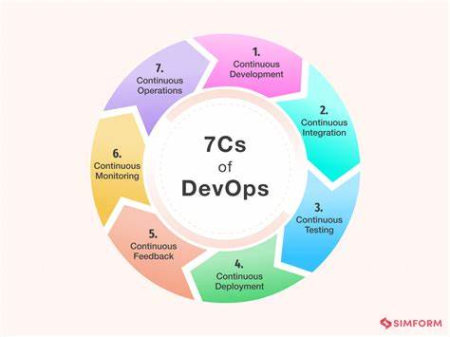

Slide 8
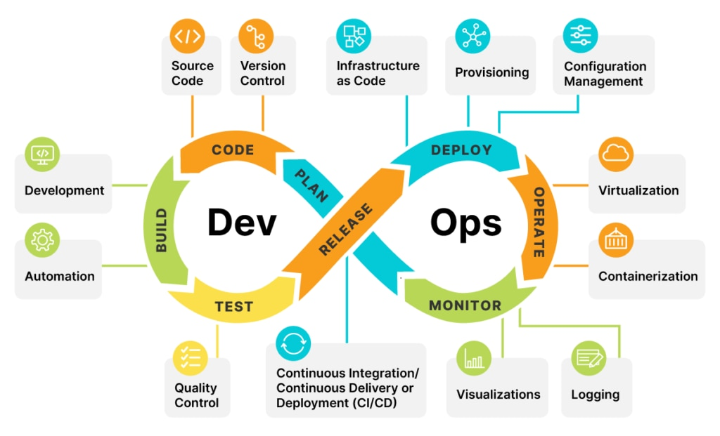

Slide 9
Benefits of DevOps
Faster time to market
Improved collaboration and communication
Increased efficiency through automation
Enhanced code quality and reduced risk
Better customer satisfaction

Slide 10
Challenges in Implementing DevOps
Resistance to cultural change
Inadequate infrastructure and tools
Lack of skilled professionals
Security and compliance concerns
Scaling DevOps practices

